Slide 1
Foreign Direct Investment Analytics
Domain-Finance

Slide 2
Problem Statement
Investment is a game of understanding historic data of investment objects under different events but it is still a game of chances to minimize the risk we apply analytics to find the equilibrium investment.
To understand the Foreign direct investment in India for the last 17 years from 2000-01 to 2016-17. This dataset contains sector and financial year-wise data of FDI in India Sector-wise investment analysis Year-wise investment analysis.

Slide 3
General KPIs
YEAR-WISE FDI (2000-2017)
BOTTOM YEARS (2000-2017)
STATE-WISE FDIS (2020-2023)
TOP YEARS (2000-2017)
TOP SECTORS (2000-2017)
BOTTOM SECTORS (2000-2017)

Slide 4
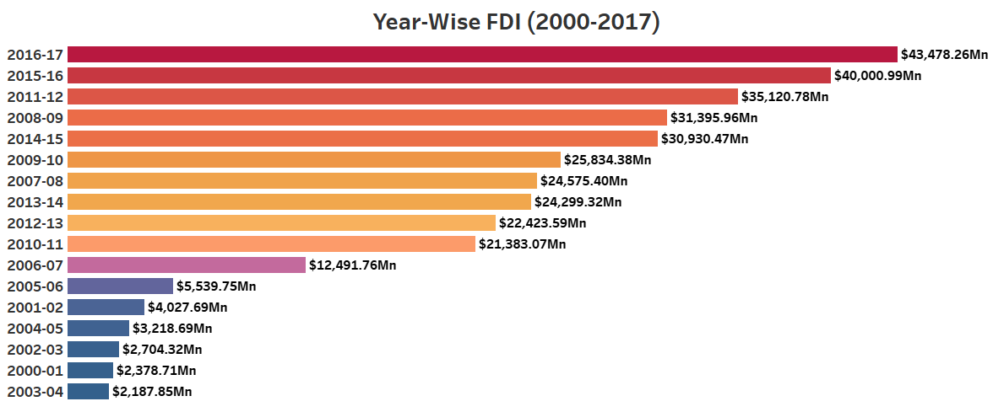
Year-Wise FDI (2000-2017)

Slide 5
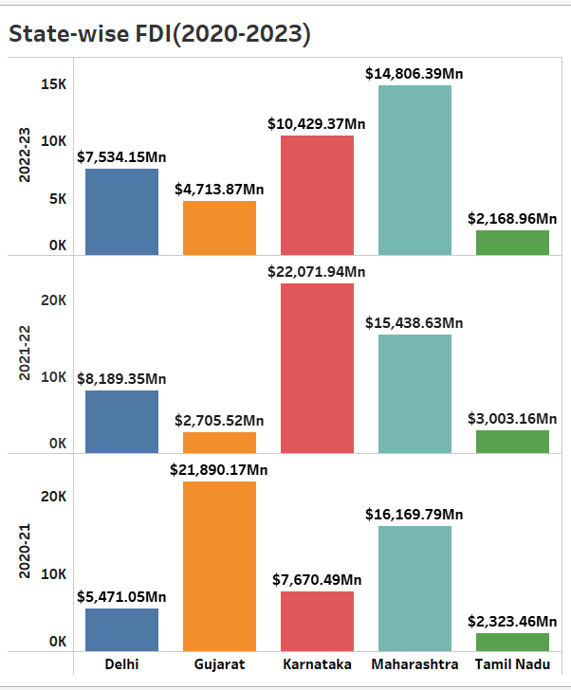
State-wise FDI (2020-2023)

Slide 6
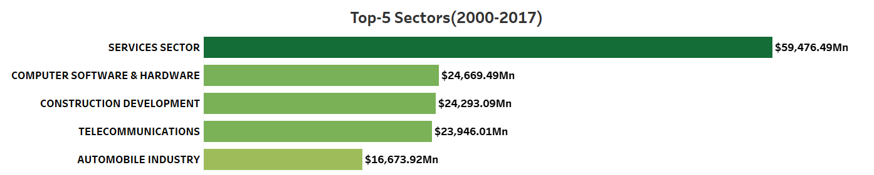
Top Sectors (2000-2017)

Slide 7
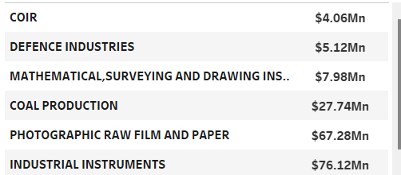
Bottom Sectors (2000-2017)

Slide 8
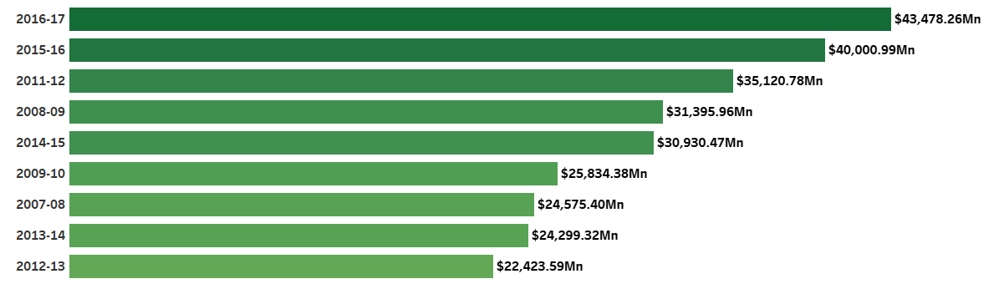
Top Years (2000-2017)

Slide 9
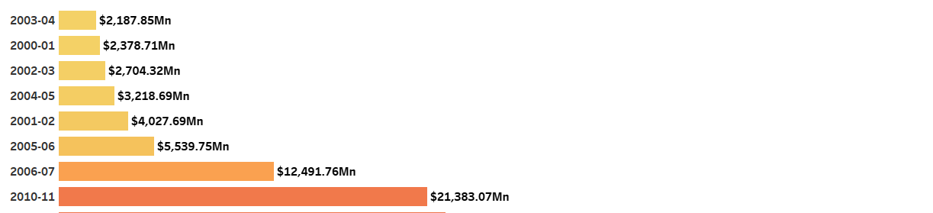
Bottom Years (2000-2017)

